Slide 1



SUSTAINABILITY MANAGEMENT
WITH 6P BOTTOM LINE - THE CMAs’ PERSPECTIVES
Sustainability Observation Month - Webinar Eastern India Regional Council
The Institute of Cost Accountants of India
January 30, 2026
Dr. Paritosh Basu, Senior Director (Services) Stragility Consulting Pvt. Ltd.
https://www.linkedin.com/in/dr-paritosh-basu-87a67a15/ www.youtube.com/results?search_query=dr+paritosh+basu

Slide 2

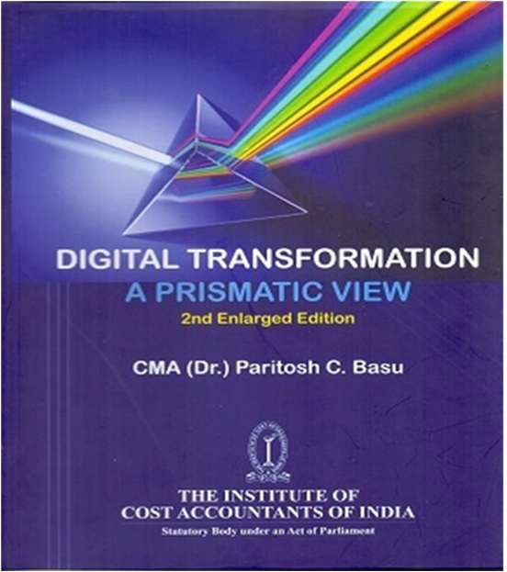
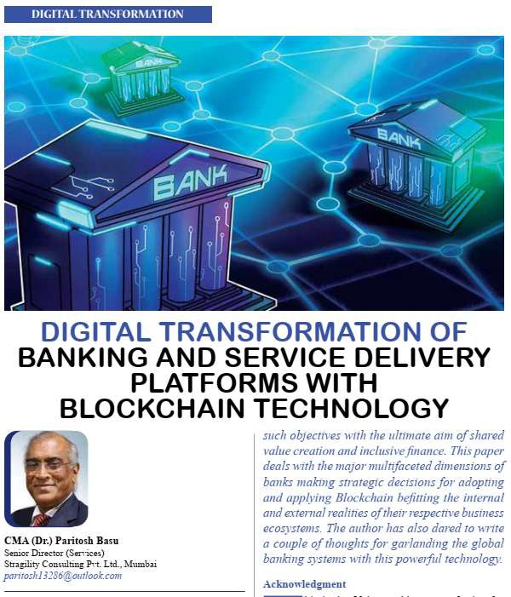
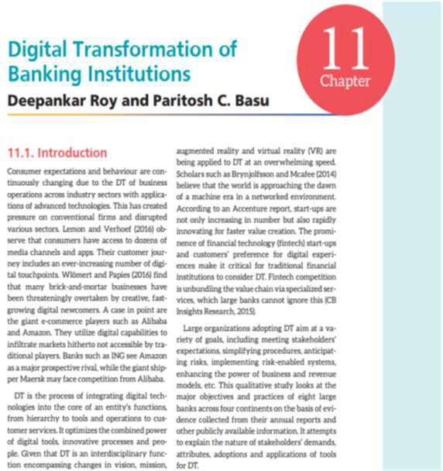



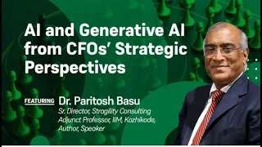
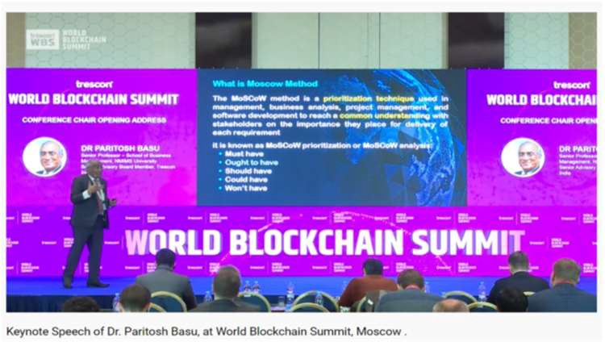
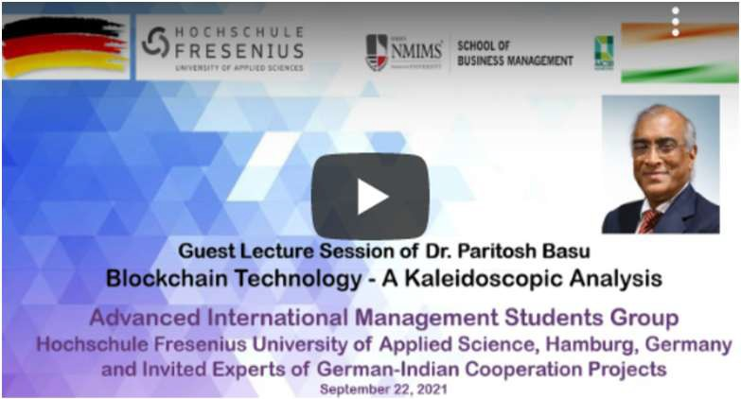
This presentation is based on this Author’s Several Published Papers
Personal YouTube Channel of Dr. Paritosh Basu
https://www.youtube.com/channel/UCXvrvkrRuhM_6TDqM9pX3EQ/vide os
@paritoshbasu
https://www.linkedin.com/in/dr-paritosh-basu-8 7a67a15/
2

Slide 3
Flow of Discussion
 Sustainability Management Revisited
 Reporting on Sustainability Management and ESG
 Key Similarities, Integration and Correlation between SM, ESG and DEI
 The Journey from 3P to 6P Bottomline
 Application of Digital Technologies for SM and Reporting
When future looks hazy, it is time to go back to basics
When future looks hazy, it is time to go back to basics
3

Slide 4

Sustainability Management - Revisited
Questions to ponder over
Is the Earth finite or infinite?
Is the capacity of the Earth limited?
Is it possible to restore or reform its capacity?
Will growth on Earth be limited to its capacity?
Can an organisation ignore such questions and grow?
Who will take the lead to answer the last question – the CEO, CFO or CDO of collectively all CXOs?
“At L&T Sustainability is embedded in our vision and growth plan.”
A.M.Naik,ChairmanEmeritus
“At L&T Sustainability is embedded in our vision and growth plan.”
A.M.Naik,ChairmanEmeritus

Slide 5

We must handover a BETTER EARTH
to the next generation. It is
our onerous responsibility, because we inherited better
We must convert sustainability management through ESG and DEI into a REVOLUTION by actions and not let it be just another agenda of any CEO and CXO

Slide 6


5. Purpose and Passion
The Sustainability Journey
4. Integrated Strategy
3. Beyond Compliance
2. Compliance
1. Pre-Compliance

Slide 7

Sustainability Management (SM) - Revisited .. 2
Sustainability Management
A strategic, cross-functional Business Imperative
For strategic, cross-functional, and systemic integration of
Environmental, Social, Governance (ESG) and Economic factors into an
Entity’s core strategies, operations, Business and Revenue Models and decision-making processes
Moves beyond traditional "green" initiatives or regulatory compliance to
Actively manage resources in a way that ensures long-term viability
Creates value and supports the 6P Bottom line with a 6R Approach
Sustainable Management
Direct the operations of an entity in ways that restore and enhance all forms of capital to generate stakeholders’ value and contribute to the well-being of current and future generations
Integrate ESG and DEI factors into business strategy
Build value by defining, evaluating and reporting on indicators beyond financial performance
Sustainable Development is the process of “Development that meets the needs of the present without compromising the ability of future generations to meet their own needs”
The Brundtland World Commission on Environment and Development, 1987
SeM focuses on active, often technical, processes, e.g., reducing carbon,
SyM represents the broader philosophy and cultural shift in organisational leadership

Slide 8

Sustainability Management – What to measure
Measurement of Sustainability emanates from Natural Capitalism
Measure development and utilisation of four types of capital
  Financial
  Manufacturing *
  Natural **
  Human beings
* Material resources and energy used in manufacturing
** Stock of natural ecosystems (flora and fauna) that yield a flow of valuable ecosystem of goods and services into the future, e. g., trees, water bodies, fresh air

Slide 9
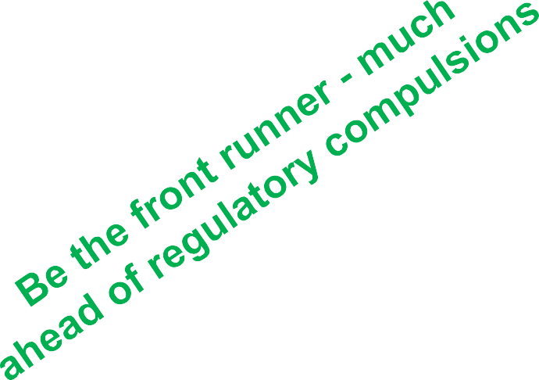
Criteria for Measurement
Social Criteria (Subjective measurement)
  Socially desirable – Society Indicators (G3.1)
  Culturally acceptable
  Psychologically nurturing
  Conforming to human rights (Charter of UNO, ILO)
Financial Criteria
  Economically sustainable
  Technologically feasible
  Operationally viable within the life cycle
Environmental Criteria
  Environmentally robust
  Utility positive
  Generationally sensitive
  Capable of continuous learning

Slide 10
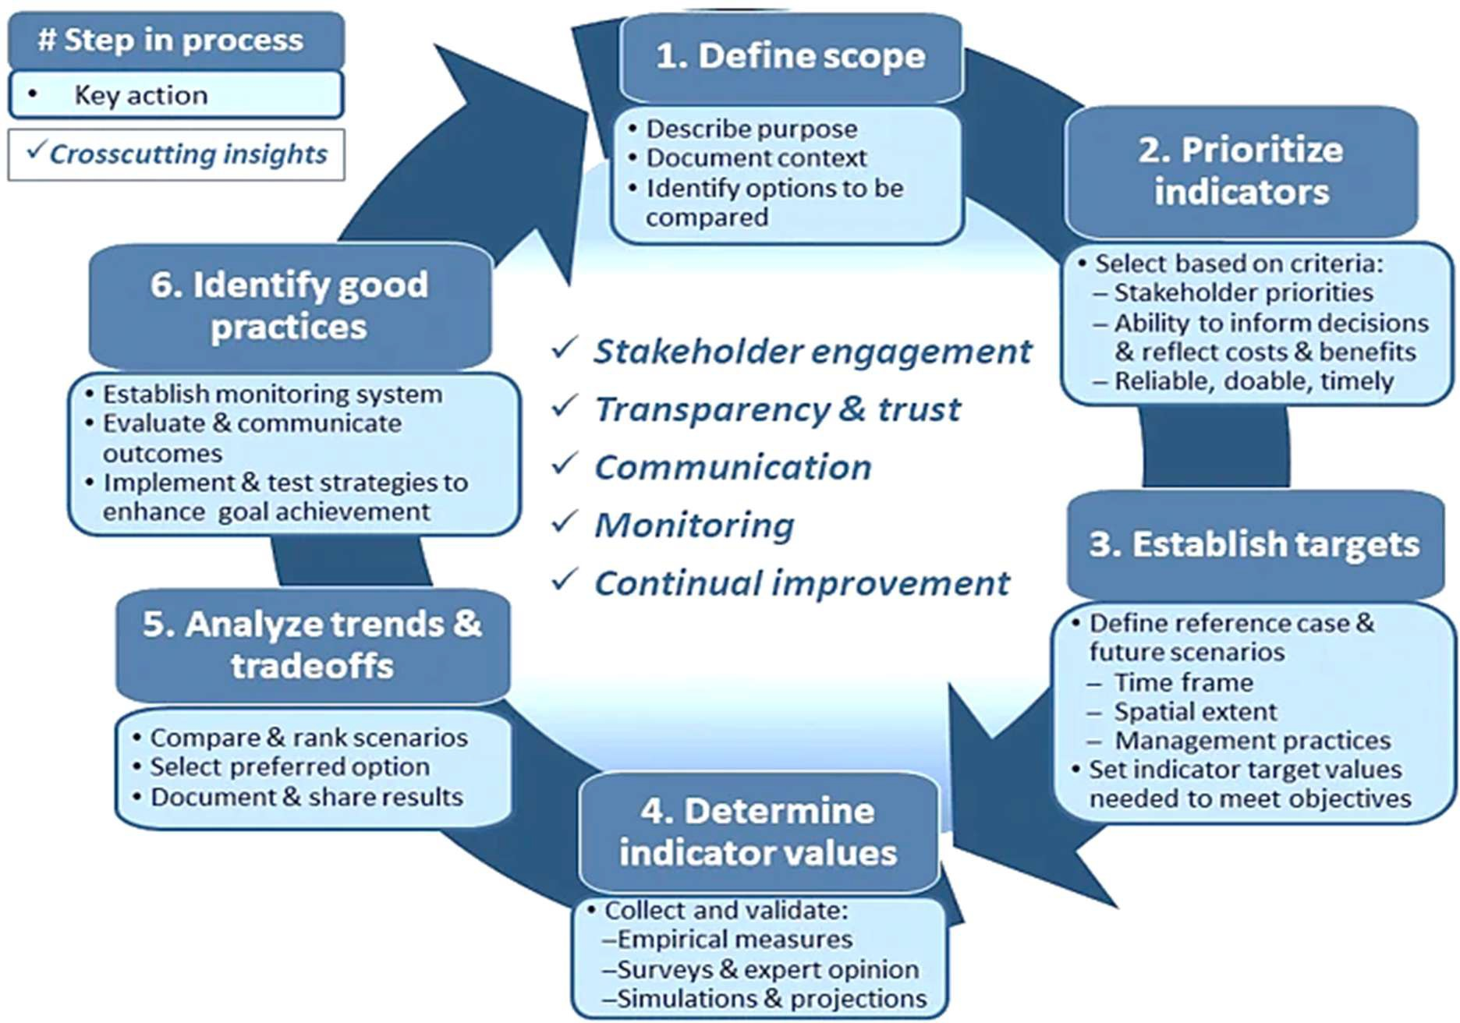
Sustainability Assessment Approach - Six actions and decision steps
Source: https://link.springer.com/article/10.1007/s10980-019-00848-1

Slide 11

4 Dimensions of Total Sustainability Management
Stakeholders
Cost Sustainability
Reputation
Technology for Social Good
Materiality
Risk-enabled Performance Management (REPM)
6P Bottomline
Products and Processes
True Sustainability
Facts-driven Decisions
Incremental or Radical
Training and Change Management
Benchmarking
Policies and SOPs
6R Action Initiatives
Clean Products
Life Cycle Design Strategy (LiDS)
Pareto Diagram
Mapping Tools
Social Life Cycle Assessment
Standards
Green Quality Tools to Reduce Environmental Impacts
Source https://www.mdpi.com/2071-1050/18/1/58

Slide 12
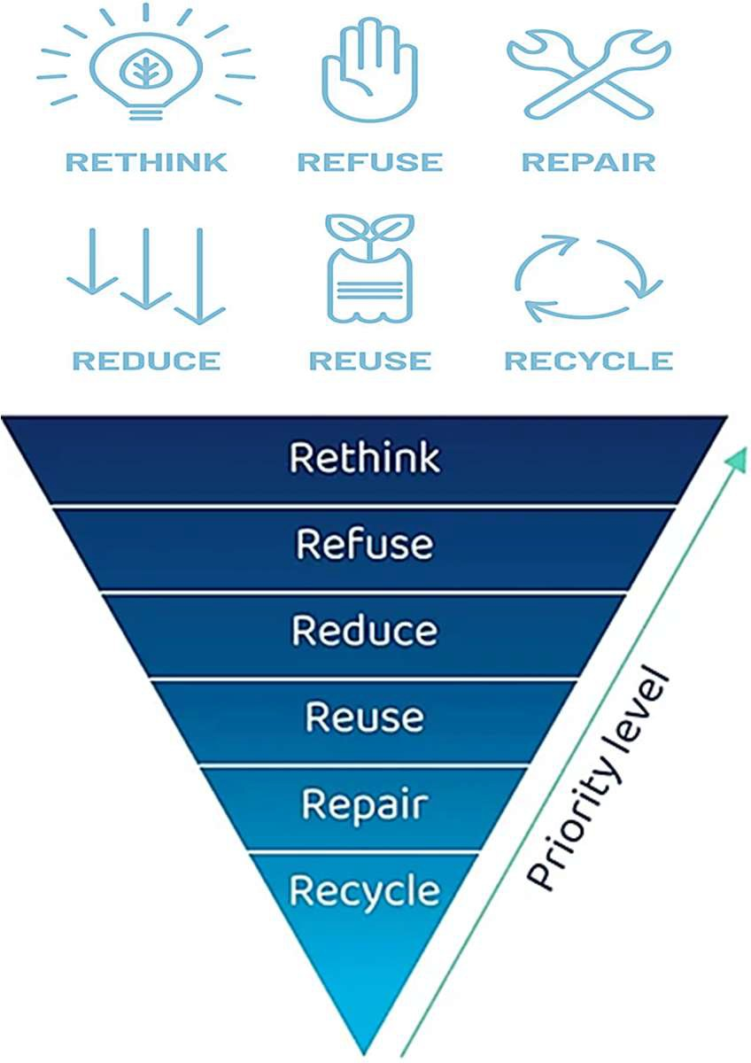
6Rs Framework of Sustainability Management
Rethink: Before you buy anything, apply NEM Analysis and rethink: Is it really needed
Refuse: Do not buy and use anything that does not add tangible value or intangible benefits
Reduce: Save or substitute to reduce material consumptions
Reuse: Before discarding and buying new to replace the old, ask if it can be reused or repurposed
Repair: It is easy to replace, but before that, explore whether it can be repaired
Recycle: If to be discarded, explore the recyclability and reuse of the materials for some other purposes
Source:https://practicalaction.org/learning/waste/the-6-rs/#:~:text=The%20'6%20Rs'%20are%20Reduce,amount%20of%20materials%20we%20consume

Slide 13
Certain Questions of CMAs to CXOs
for operations planning and budgeting process renigeering
What are the plans, action points, capital and revenue expenditure for
Reducing material intensity
Utility audit and reducing consumption of power, fuel, steam, water, etc.
Optimisation and substitution of raw natural resources
Minimising dispersion of toxic substances
Green logistics for renewable and used products
Recycling of scrap, wastage and spoilage
Prolonging product life at minimum differential price
Increasing service intensity to reduce frequency
CXOs to ensure viability and growth after absorbing all these expenditure
Similar points are also to be ensured by vendors
Similar points are also to be ensured by vendors

Slide 14

Reporting on Sustainability Management and ESG

Slide 15

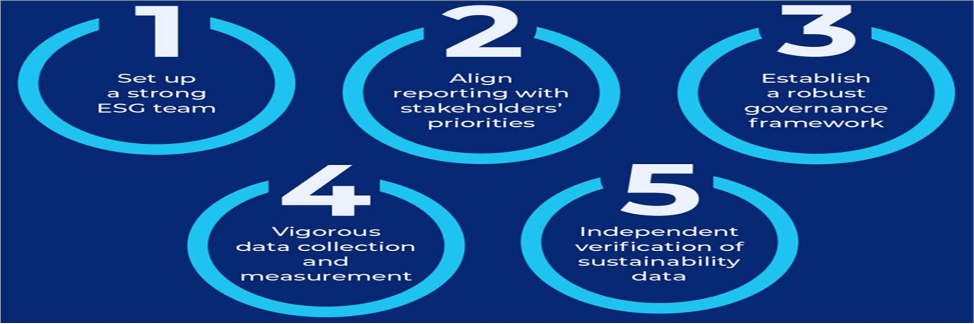
Corporate Sustainability – Imperatives and Best Practices for Reporting
Source: https://www.scalefocus.com/blog/5-best-practices-for-sustainability-reporting

Slide 16
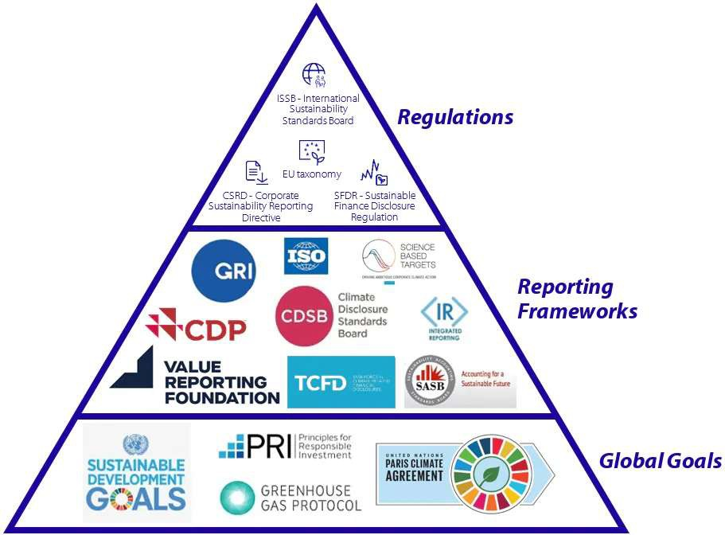
Sustainability Reporting Regulations, Reporting Frameworks, and Global Goals
This list of Regulations, Frameworks, and Global Goals is not complete, as there are many standards worldwide that vary by region.
The infographic aims to help understand the underlying connections and principles in the sustainable reporting environment.
Source: An Introduction to the Sustainability Reporting Landscape - Rabobank

Slide 17
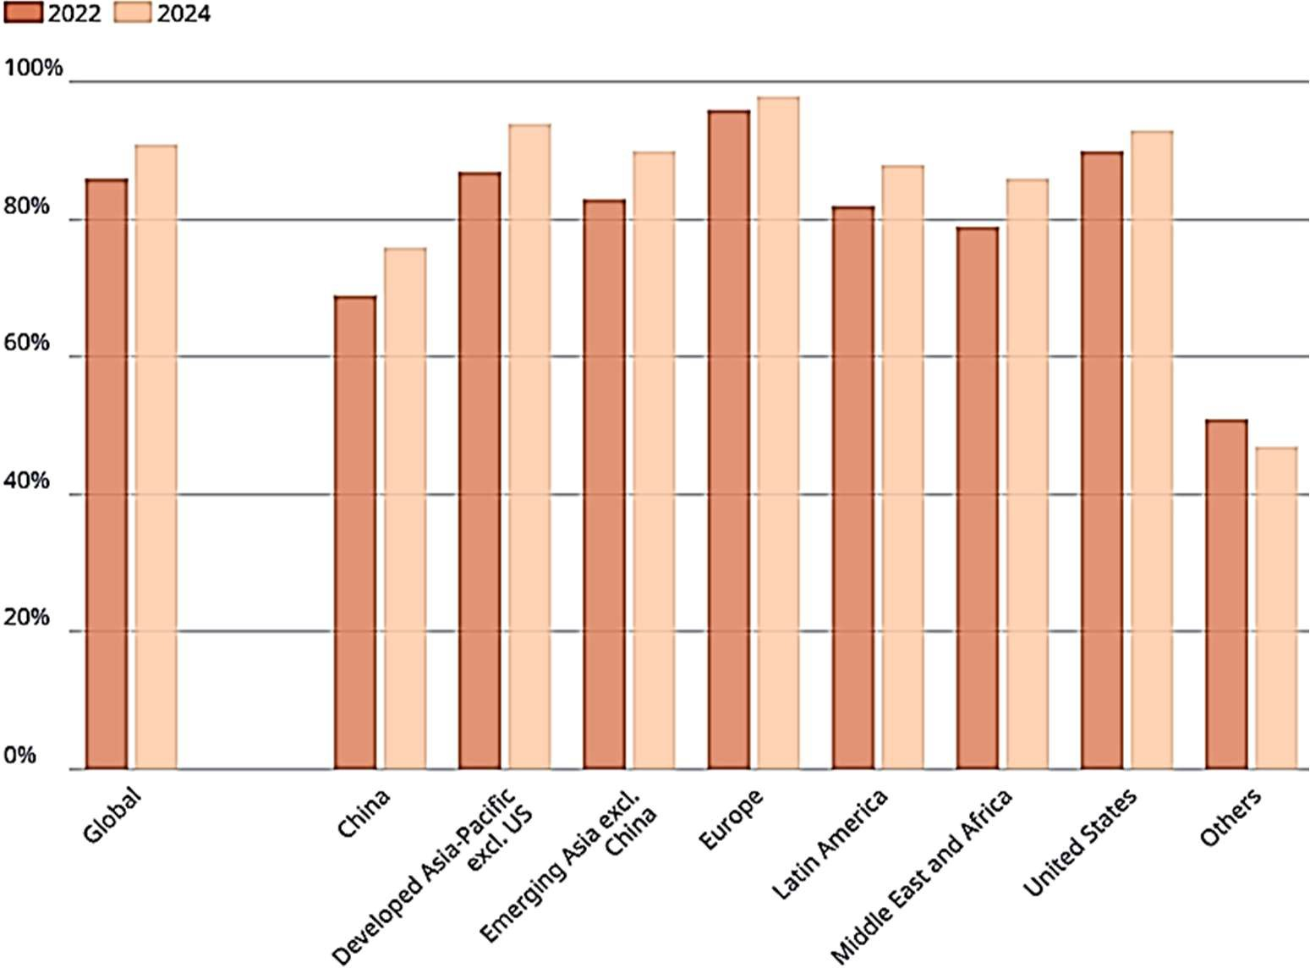
Global Corporate vDisclosures on Sustainability vs. Market Capitalisations
Between 2022 and 2024, corporate sustainability disclosure grew steadily
By 2024, 91% of global market capitalisation-weighted Cos. reported sustainability information (2022 - 86%)
Europe (98%), developed Asia-Pacific excluding the US (94%), and the US (93%)
The total number of disclosures is still < one-third of all listed entities worldwide
Source: https://www.oecd.org/en/publications/2025/10/global-corporate-sustainability-report-2025_57b105f2.html

Slide 18

Sustainability Reporting in India - Status as of 2025
Core Shifts
Transition from voluntary CSR-style disclosures to mandatory, audit-ready ESG reporting
Driven primarily by SEBI’s BRSR Framework for the top 1,000 listed companies
Key Features
Mandatory BRSR: Detailed ESG disclosures across environmental, social, and governance pillars.
BRSR Core (Top 250 firms)
  Reasonable assurance required on high-priority metrics
  Focus on supply chain, carbon footprint, and social impact
Carbon Market Integration:
  Operational domestic carbon credit trading system
  Corporate reporting linked to carbon pricing mechanisms
Greenwashing Controls: ASCI enforces evidence-based sustainability claims
Priority Themes: Climate risk, biodiversity, employee well-being, gender diversity
Digital & AI Adoption: Use of AI, Digital Twins, and ESG Platforms for data management and assurance

Slide 19

Sustainability Reporting in India - Status as of 2025 …2
Regulatory & Market Trends
Value Chain Transparency: Stronger scrutiny of upstream and downstream impacts
Global Alignment: Convergence with ISSB and partial alignment with EU CSRD
Stricter Enforcement: Push toward measurable sustainability performance, not tick-box compliance

Slide 20
No Sustainability Reporting No Access to Equity Capital
Global stock exchanges are increasingly embedding ESG and Sustainability disclosures Into their listing and IPO requirements
India’s BSE and NSE mandate SEBI’s BRSR for the top 1,000 companies
China’s Shanghai, Shenzhen, and Beijing exchanges require sustainability reports under the new 2024 guidelines
Hong Kong’s HKSE enforces climate-related disclosures aligned with IFRS S2
Malaysia’s Bursa has required ESG reporting since 2016
South Africa’s JSE follows a comply-or-explain integrated reporting model
Switzerland’s SIX Exchange mandates sustainability reporting for certain firms, and the
The UK’s LSE requires listed companies to disclose greenhouse gas emissions.
Note
  The above list is just illustrative. There are other Stock Exchanges like of Tel Aviv
  Collectively, these exchanges are making SM and ESG transparency a standard expectation for listings and IPOs

Slide 21

Key Similarities and Correlation and Integration between Sustainability Management, ESG and DEI

Slide 22

ESG and SM - Key correlations and similarities
Key Correlations and Similarities
Shared Objectives: Both aim to manage risks and improve a company's impact on the environment, society, and governance
Performance Measurement: ESG metrics (e.g., carbon emissions) provide the specific data needed to track progress toward sustainability goals
Investment & Reputation: A strong correlation exists between high ESG performance and financial success, as investors use these metrics to identify resilient, sustainable companies
Strategic Integration: Modern businesses use SM to shape core strategies, which are then reported via ESG frameworks to meet investor and regulatory demands
Differences in Application
Sustainability Management: Internal, holistic, and long-term focus on operating responsibly
ESG: External, specific, and data-driven, focused on risk assessment for investors
Research Reports suggests
High ESG scores correlate with improved financial performance,
ESG and SM are closely intertwined in promoting overall corporate, social, and environmental accountability.

Slide 23

Approaches to ESG Management
Conformist | Pragmatic | Strategic | Idealistic
“I believe in | “I believe that | “I believe that ESG | “I believe that ESG
financial return | ESG is an | is a part of the | is my purpose, and,
and consider | important factor | firm’s purpose | in living that
ESG as just a | that influences | and that it will | purpose, I can
regulatory | the firm’s | ensure long-term | maximise
boundary.” | performance.” | success.” | sustainability.”

Slide 24

ESG Intelligence - Approaches and Impacts
Strategic & Vision-Driven
An ESG-intelligent organisation doesn’t just measure impact - it designs for it, aligning profit with purpose and intelligence with integrity
Systems Thinking
When intelligence meets responsibility, organisations evolve from doing less harm to creating more good; that is the true power of ESG intelligence
Future-Ready
ESG-intelligent organisations don’t wait for the future; they build it by making sustainability a capability, not a compliance exercise
Leadership Tone
“Intelligent organisations lead with values, act with data, and grow with purpose - That is the essence of ESG maturity
Executives
“ESG intelligence turns sustainability into strategy and strategy into long-term advantage

Slide 25

Actions for Transformation to an ESG Intelligent Organisation
Enhance physical and digitalised capabilities to
Select the right organisational practices that are aligned with its strategic orientation towards ESG
Craft business model, revenue model and organisational context with 6P Bottom Line
Train and sensitise all to apply ESG and DEI -Intelligent practices
Enhance intelligence for augmenting capacity to capture for once and synthesise all needful information
Convert data to information and then to knowledge
Understand difference and linkages between new information and previous knowledge
Apply the resulting insights at scale through decision support tools like that of AI, ML and DL
Apply the right digital technologies for the right purpose with ESG imperatives in mind

Slide 26

Sustainability Management and DEI - Key Correlations
Sustainability Management and Diversity, Equity, and Inclusion (DEI)
Recognised as deeply intertwined,
Mutually reinforcing drivers of long-term business resilience, innovation, and ethical performance
SM focuses on environmental, economic, and social longevity
DEI provides the human-centric ‘Social’ (S) pillar of Environmental, Social, and Governance (ESG) frameworks
Key Correlation and Synergies
True Sustainability: is not achievable without Equity for and Inclusion of all stakeholders
Integrated Social Responsibility: DEI is essential to the ‘S’ of ESG to ensure human rights and community impacts
Enhanced Innovation: Diverse teams bring unique perspectives for innovative problem solving
REPM and Resilience: Commitment to DEI strengthens governance by fostering transparency, reducing discrimination, and compliances
Talent Attraction and Retention: Prioritising DEI attracts contemporary values-driven employees, particularly Millennials and Gen Z
Improved Brand Reputation: Stakeholders demand ethics, and companies with strong DEI practices build higher trust and brand loyalty to attract Millennials and Gen Z

Slide 27
Operationalising the Links for Interwinding SM with DEI
Board and Leadership Diversity: A diverse board of directors is better equipped to
  Guide through crises,
  Contribute to higher profitability while attaining DEI objectives, and
  Thus, ensure better ESG performance for ultimate excellence in SM
Inclusive Supply Chains: Integrating DEI into procurement
  With diversified suppliers to boost community well-being and
  Reducing environmental footprints by sensitising diverse suppliers for DEI and SM
Metrics and Reporting: The Frameworks, like the EU’s Corporate Sustainability Reporting Directive
  Force companies to report on both environmental impact and
  Social data like board diversity and pay equity
  Make the connection formal and auditable
Challenges in Alignment
  Unconscious bias in the workplace
  Resistance to change, and
  Difficulties in implementing, measuring, and reporting on DEI metrics
Successfully navigating these requires embedding DEI into the corporate strategy rather than treating it as a separate initiative

Slide 28

The Journey from 3P to 6P Bottom Line Dimensional Aspects of Desired Impacts of SM

Slide 29
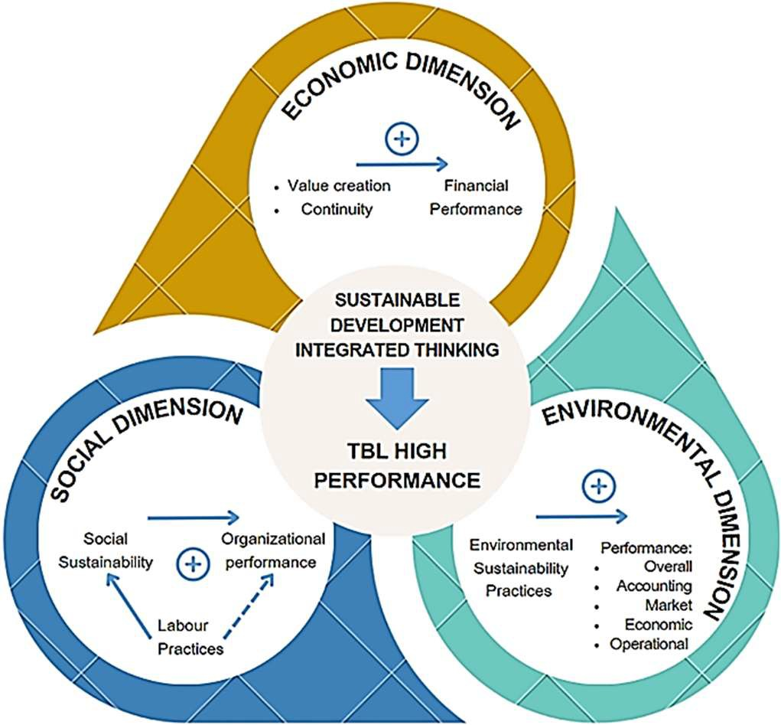
Triple P Bottom Line or Three Pillars of Sustainability Management
3P Bottom Line was coined by Prof. John Elkington, a global authority on Sustainable Capitalism in 1994.
Promote sustainable development with integrated thinking and changing the corporate mangers mindset from accountability to all stakeholders instead of only shareholders
Triple P Framework ensures that an organisation is accountable for its impact on society, the environment, and its financial health
  People (Social): Focuses on fair labour practices, community involvement, and human capital.
  Planet (Environmental): Focuses on ecological stewardship, reducing waste, and using renewable energy
  Profit (Economic): Ensures financial viability while operating sustainably.

Slide 30
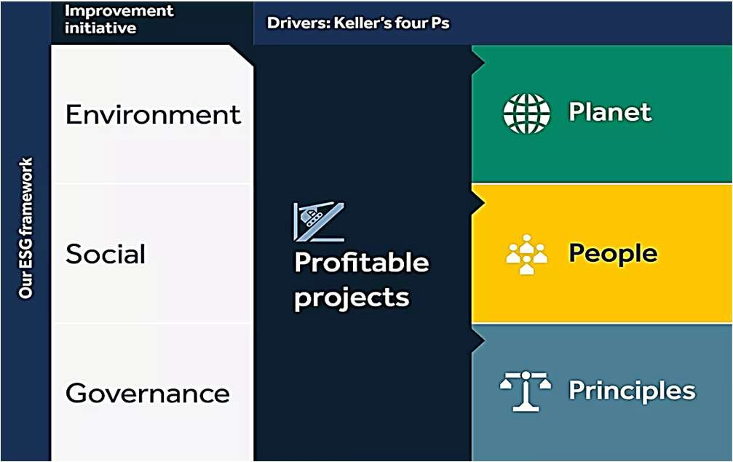
Expanded Frameworks of Sustainability Management
Keller Group is of the view that the 3Ps of Sustainability Management cannot be achieved without appropriate Principles for Governance, and thus they added Principles as the 4th P that would lead to better governance

Slide 31

UNO’s 5Ps for 17 SDGs
The 5Ps, viz., People, Planet, Prosperity, Peace, and Partnership, are the foundational pillars of the UN 2030 Agenda, designed to balance social, environmental, and economic sustainability.
The 5Ps integrate the 17 Sustainable Development Goals s to ensure that development efforts:
  Protect the earth,
  Foster inclusive growth, and
  Guarantee peace through global cooperation.
Source: https://wenaturalists.com/explore-detail/blog/sdg

Slide 32
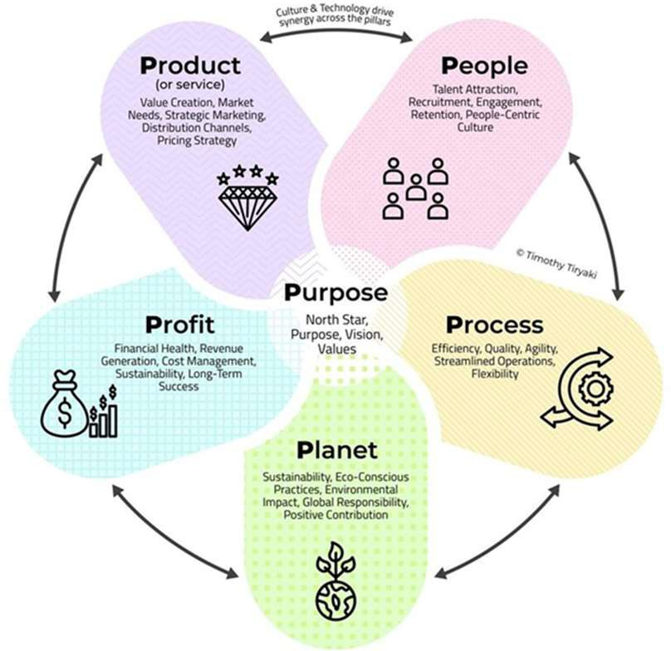
8Ps of Sustainability Management
People (Social Equity & Responsibility): Fair labour practices, DEI, and community well-being
Planet (Environmental Stewardship): Minimising the ecological footprint and circular economy principles,
Profit (Economic Viability & Ethics): ensuring long-term financial health while operating ethically
8Ps of Bottom Line
Process (Operational Efficiency)*: Refers to streamlining workflows and sustainable production techniques with the 6R Framework
Platform (Digital Innovation and Technology)*: Using digital technologies to optimise operations, improve tracking of sustainability metrics, and enable remote collaboration
Partnership (Collaborative Value Chain): Engaging with suppliers, customers, and non-profit organisations that share similar values to create a positive, collective impact
The 7th and the 8th Ps are Purpose and Peace to ensure that the guiding mission for the commercial organisations is to exist beyond mere profit

Slide 33
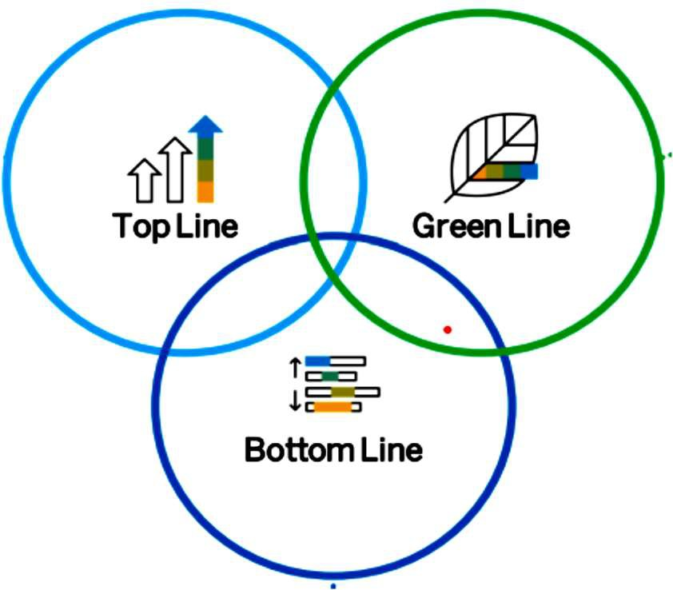
Add to Top Line and Bottom Line the Green Line
Top Line (Revenue)
Maximise from revenue streams
Create new business models
Create ne revenue models
Green Line (Profit)
Deliver sustainable products
Reduce carbon footprint
Be proactively compliant
Report transparently
Bottom Line (Profit)
Maximise value creation
Minimise value destruction
Strategic cost management
Apply NEM and RAGE Analyses
Source:https://www.sap.com/documents/2022/12/5e317cf9-537e-0010-bca6-c68f7e60039b.html

Slide 34
6P Bottom Line - The Strategic imperative for SM
Planet
Peace for humanity is one of the ultimate objectives of sustainability
Peace
Profit
Prioritization of each P factor would depend upon specific features of the industry sector and firm
6P Bottom Line for SM
Let us strive for:
Inclusive growth
Inclusive fortune
Inclusive smile
Inclusive happiness
Prosperity
People
Product

Slide 35

Application of Digital Technologies
For Sustainability Management and Reporting

Slide 36
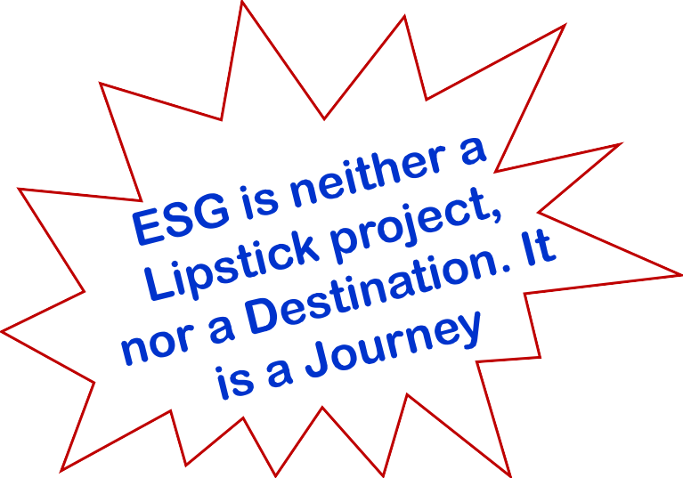
Digital Transformation (DT) for Risk-enabled Intelligent SM
Digital Transformation is not a statement of intent, but the strategic imperatives for CEOs
DT of operating processes for creating, preserving, sharing and exchanging values
Technologies are fast evolving by merging the physical, digital and biological worlds into one
DT and SM are moving up the CEO’s imperatives and strategic agenda as inseparable twins
DT of the entire value chain for a smarter generation, desirable results for all stakeholders
Digital Technologies for DT of ESG Management
Blockchain Platform(s) for end-to-end management of
  Complaints from stakeholders and closure thereof
  Management of Government grants and subsidies
  Exchange for Green Bonds issued by corporates and governments
  Collecting and monitoring of data from Sensors, IoTs, IIoTs, AIoTs, Drones
  ESG and DEI credentials by authorized agencies to corporates and skilled personnel
  Tokenized carbon credit transactions both at domestic and global eMarketplace
AI, ML, DL, GnerativeAI (selectively)
Humanoids, Robots, Robotic Process Automation
Web3, Metaverse and 3D Printing

Slide 37
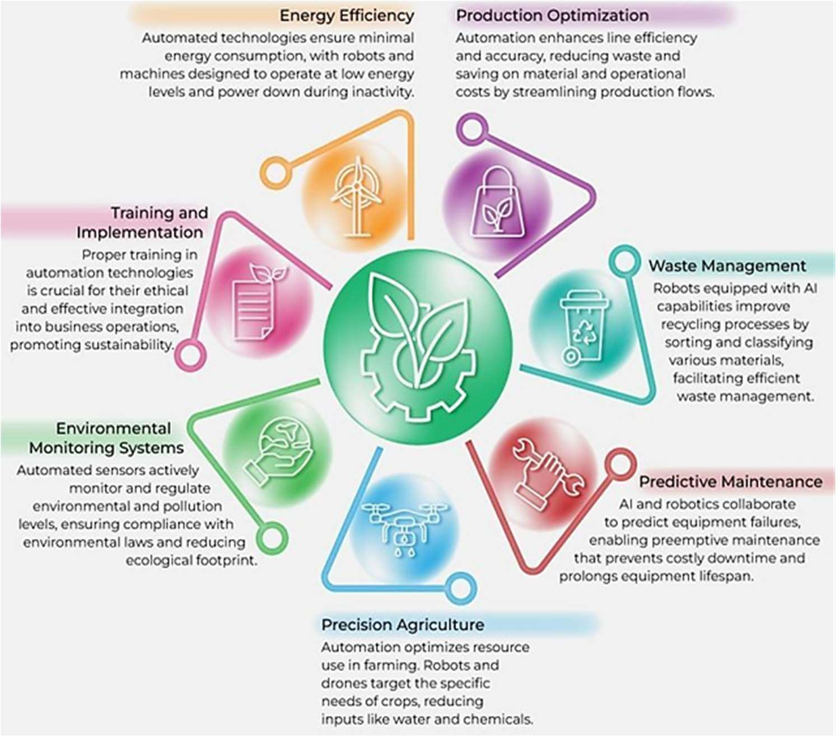
Leveraging Automation and Robotics for Sustainable Business Practices
Intergrade cutting edge technologies to streamline resource usage and reduce wastage within the corporate framework, enhancing both environmental responsibility and operational efficiency
Source https://www.linkedin.com/posts/antgrasso_automation-robotics-sustainability-activity-7422579529640083456-
UYBa/?utm_source=share&utm_medium=member_ios&rc m=ACoAAAMf114BBzAJfo0ICykhFVl4vcNiSXp16YI

Slide 38
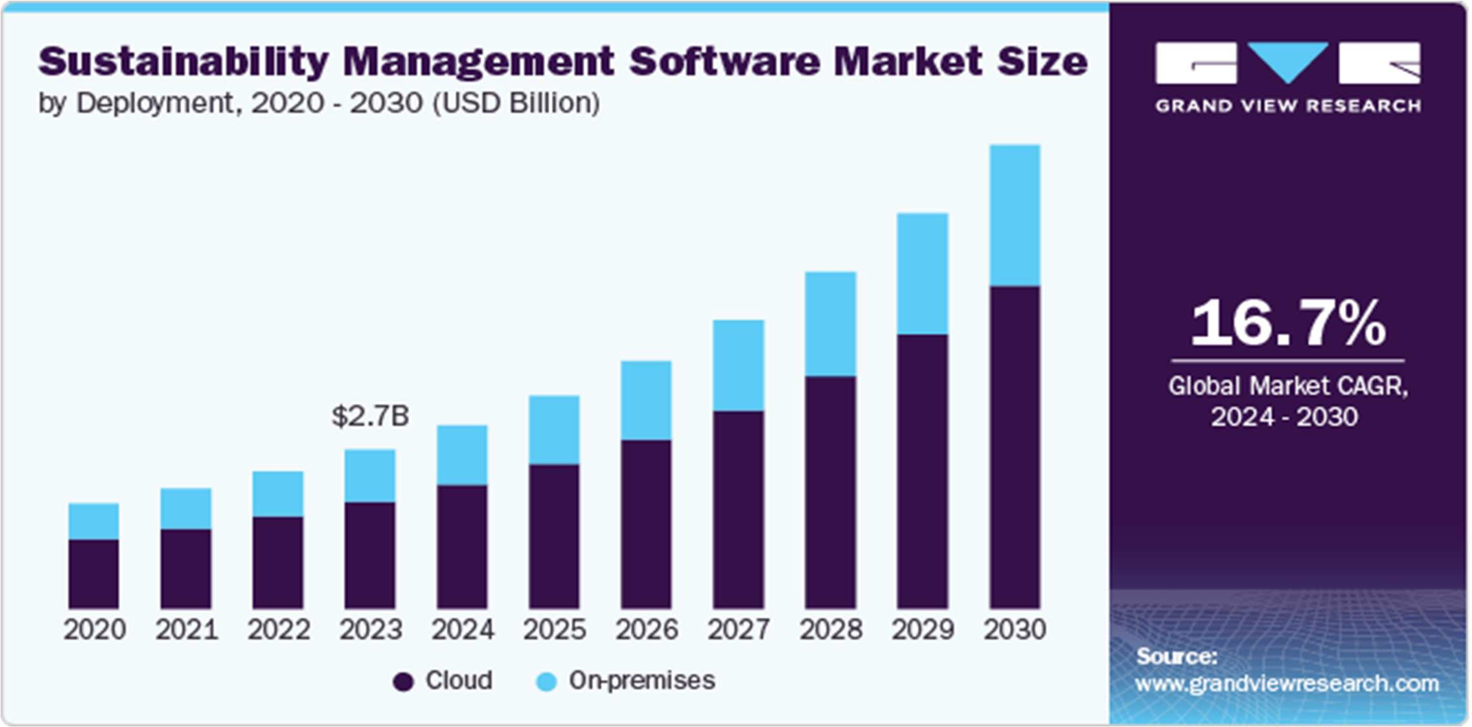
Source: https://www.grandviewresearch.com/industry-analysis/sustainability-management-software-market-re

Slide 39
Certain Action Points for Coordinated Initiatives and Collaboration
Adopt Digital Technologies to establish one version to truth
Work towards globally consistent ESG Standards
Elevate the S Agenda and leverage social reporting and audit
Effective ESG Strategies require top-down driven change
Introduce Objective Measurement What can’t be measured can’t be done and controlled
We need a scientific approach to target for Social Reporting
Link compensation to specific, numerical targets
Document the financial impact of Non-financial Indicators
Transparency, Consistency and Comprehensiveness of reporting

Slide 40
Thank You

