Slide 1
ESG AND BRSR REPORTING
27th January, 2026
CMA Rambabu Pathak
B. Com (H), ACMA, ACS, PGDM
PhD Research Scholar, NIT-Rourkela
Company Secretary
Eastern Coalfields Limited

Slide 2
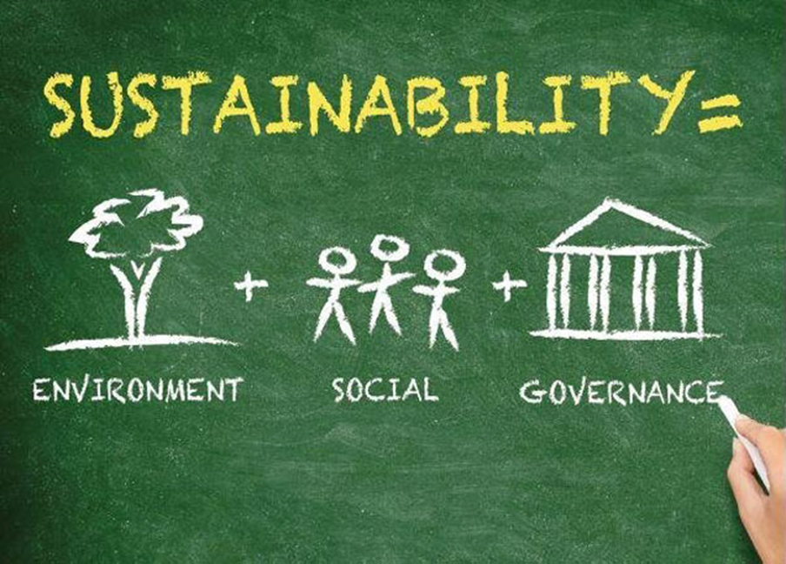

Slide 3
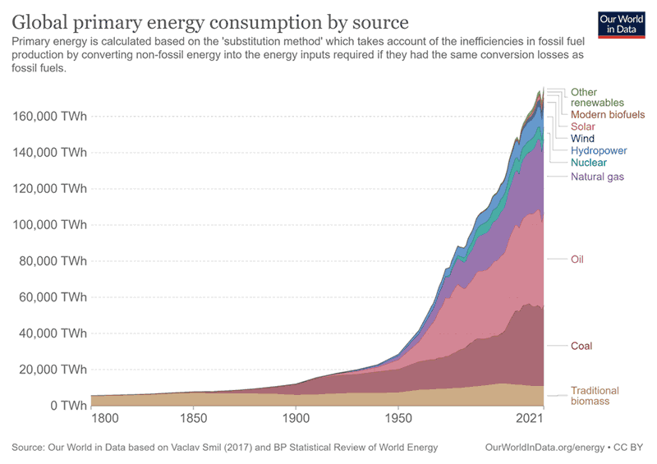
3

Slide 4
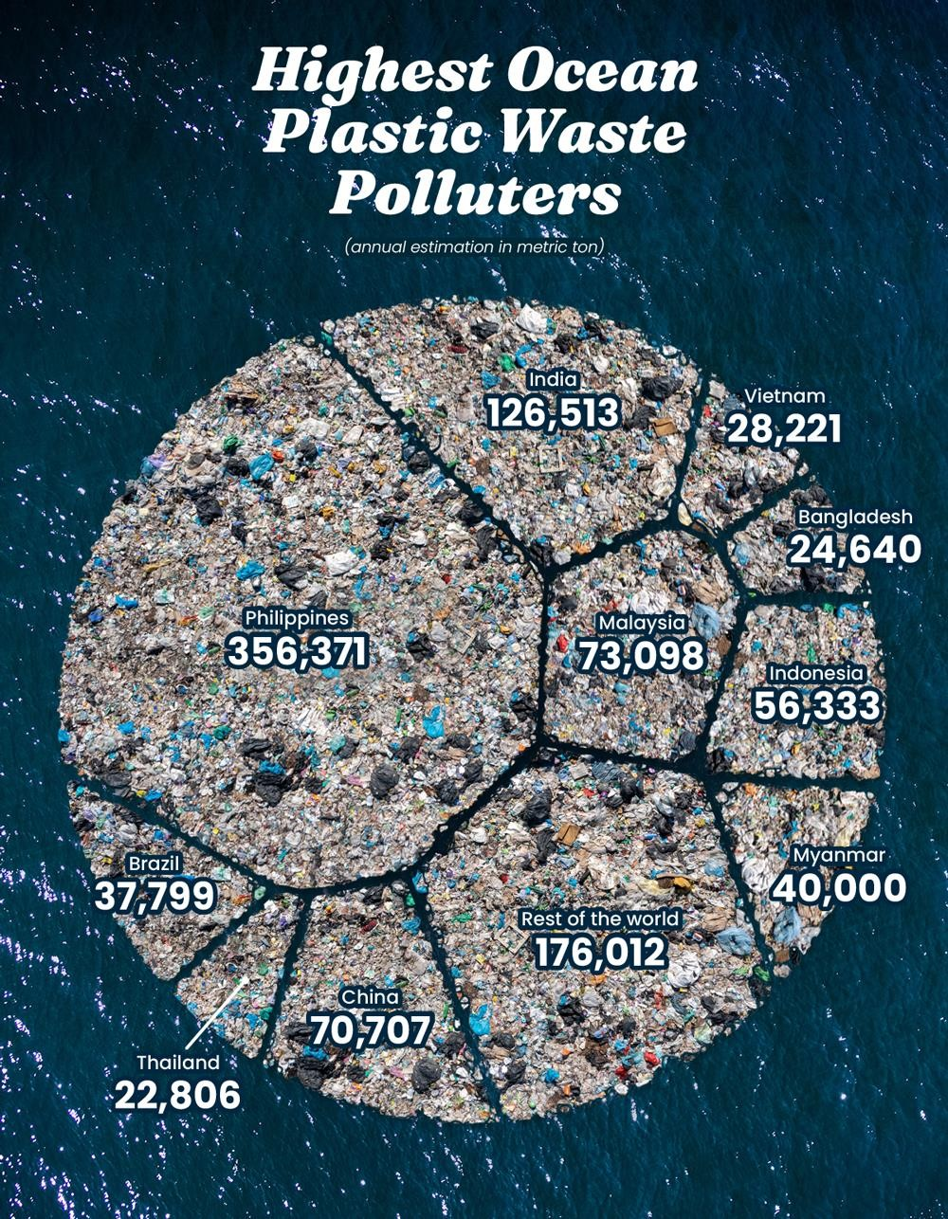

4

Slide 5

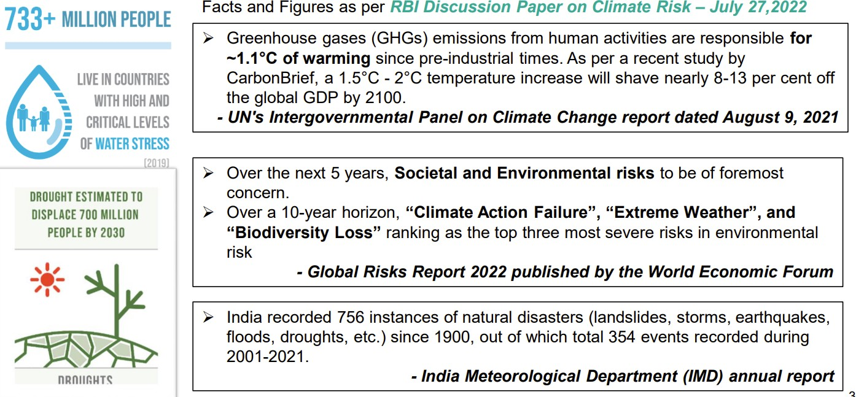
5

Slide 6
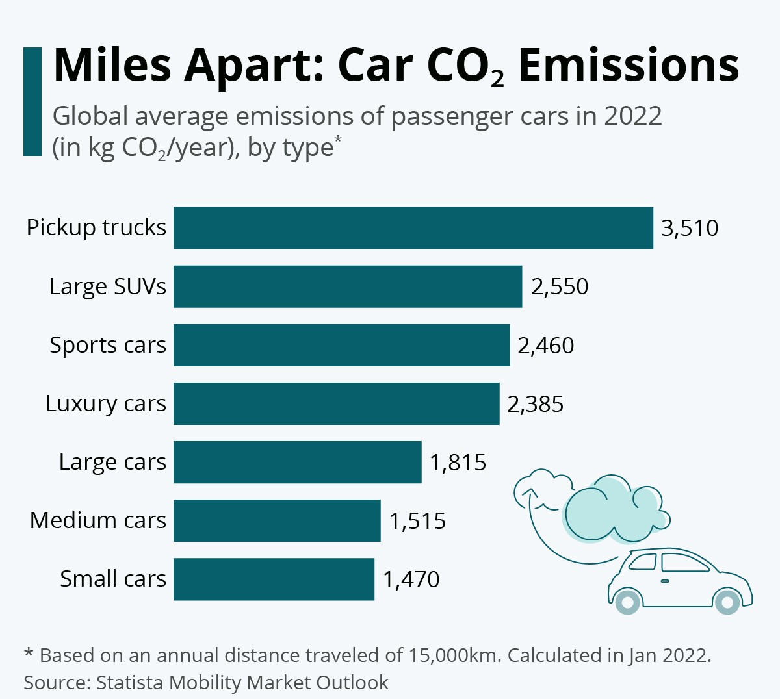
Source: World Economic Forum: Which passenger cars pollute the most? https://www.weforum.org/agenda/2022/04/most-polluting-passenger-cars/
7

Slide 7
The most often quoted definition comes from the UN World Commission on Environment and Development:
“Sustainable development is development that meets the needs of the present without compromising the ability of future generations to meet their own needs.”
“Sustainability is based on a simple principle: Everything that we need for our survival and well-being depends, either directly or indirectly, on our natural environment.”
To pursue sustainability is to create and maintain the conditions under which humans and nature can exist in productive harmony to support present and future generations.

Slide 8
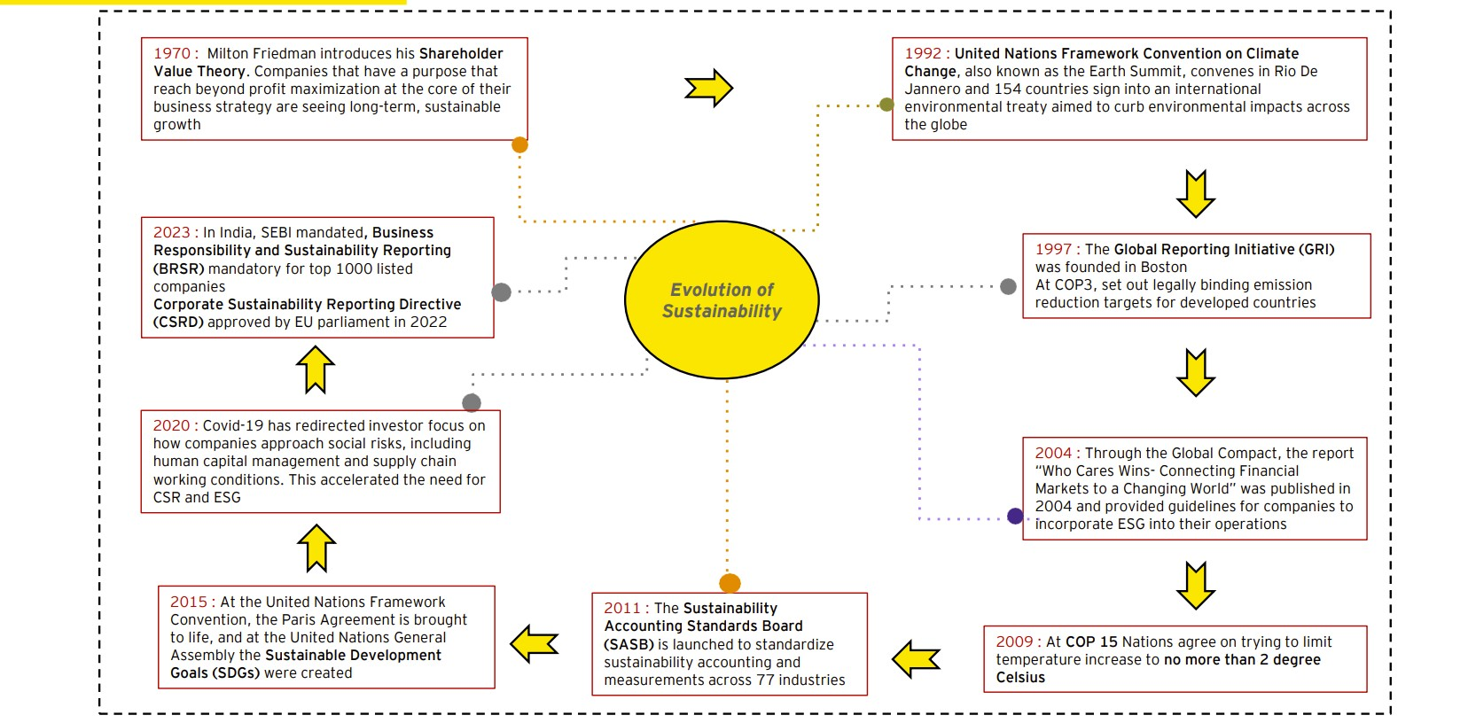

Slide 9



Definition of corporate sustainability
The property of being environmentally sustainable; the degree to which a process or enterprise is able to be maintained or continued while avoiding the long-term depletion of natural resources.” – Oxford

Slide 10
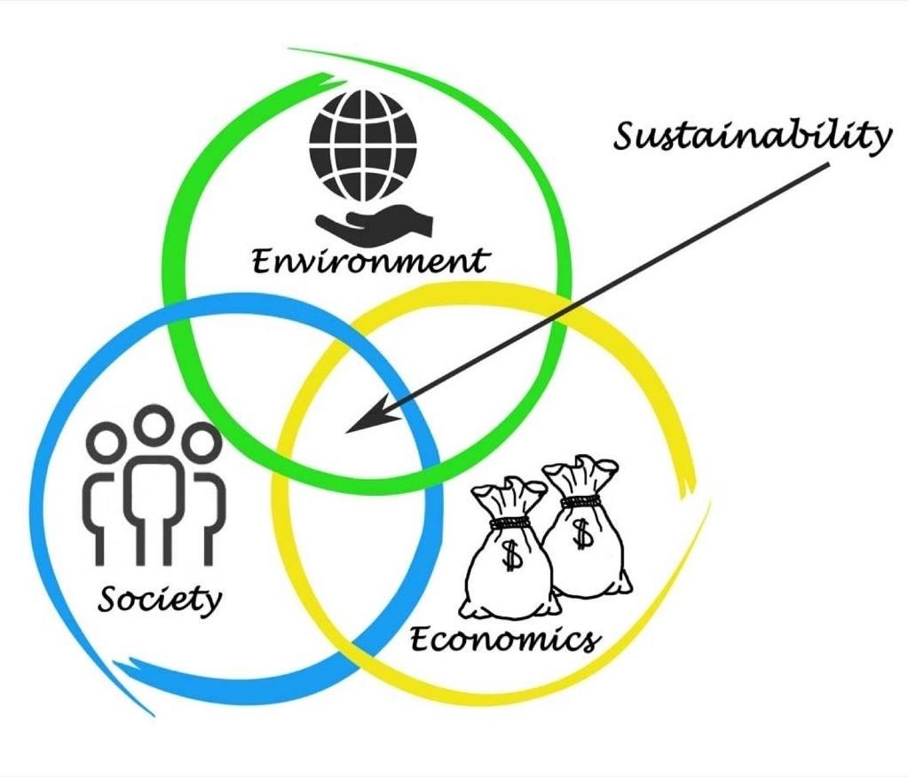
Business sustainability refers to the effect companies have on the environment & society.
Some of the global issues that sustainable business strategies help to address include:
Climate change
Income inequality
Depletion of natural resources
Human rights issues
Fair working conditions
Pollution
Racial injustice
Gender inequality
11

Slide 11
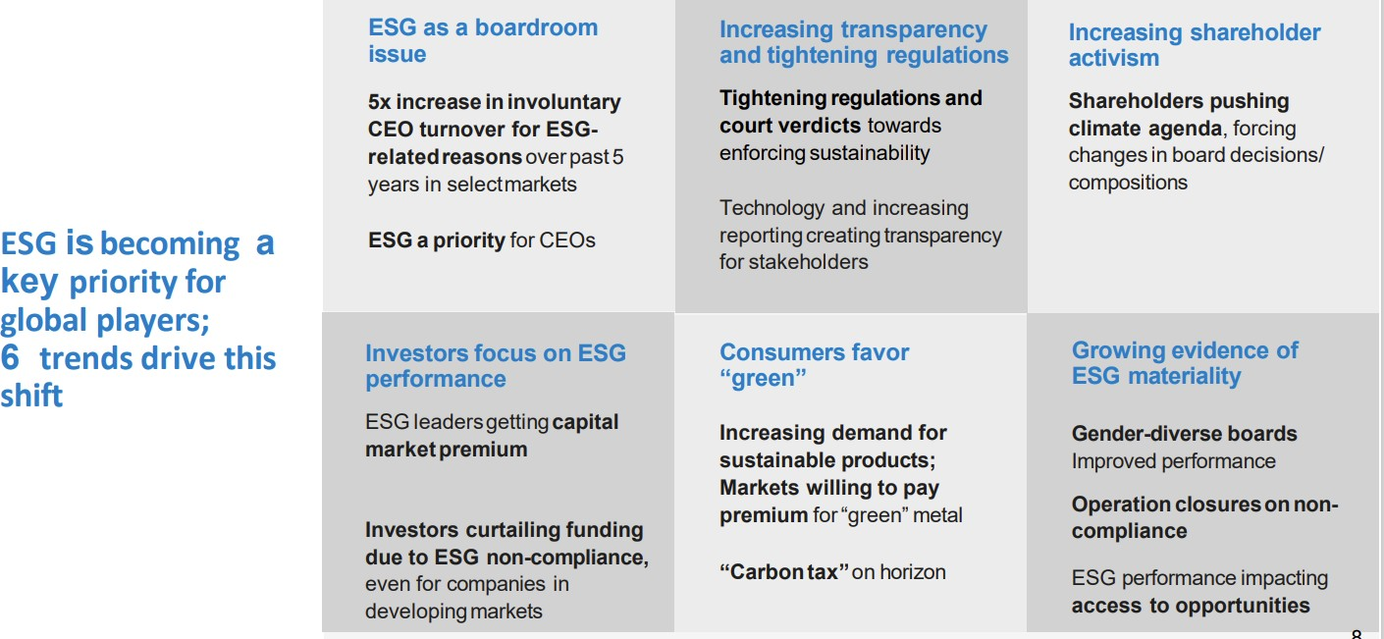

Slide 12
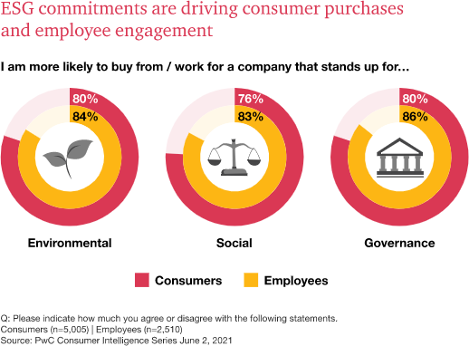

Growing Environmental Awareness: Increased recognition of environmental challenges (e.g., climate change, pollution).
Stakeholder Expectations: Customers, employees, investors, and regulators demand responsible practices. Accountability for social and environmental impacts is required.
of investors surveyed evaluate nonfinancial disclosures, either formally or informally
98%
83%
of investors surveyed consider formal frameworks to be necessary in assessing long-term value
75%
of investors surveyed would find value in assurance of the robustness of an organization’s planning for climate risks

Slide 13
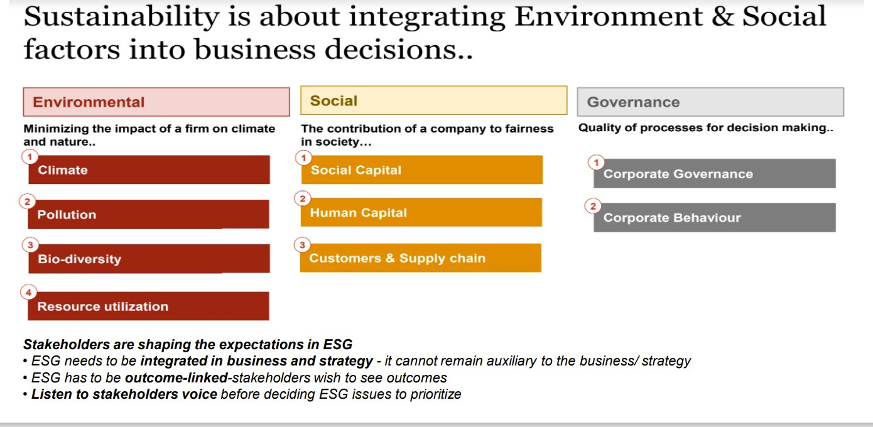



Slide 14
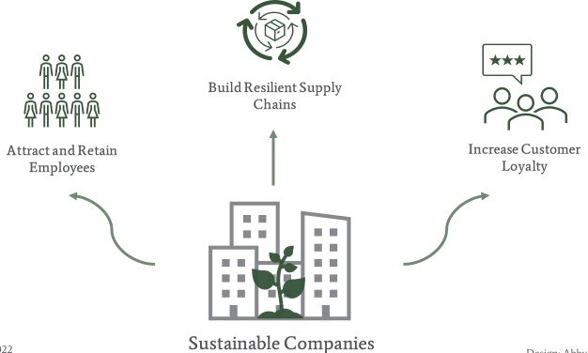
Business Benefits: Sustainable practices lead to cost savings, improved brand reputation, and customer loyalty.
Regulatory Pressures: Governments impose stricter environmental and social standards. Incentives for businesses to adopt sustainable practices.
Ethical and Social Considerations: Recognition of business responsibility in addressing social and ethical challenges.
Reporting and Transparency: Increasing demand for sustainability reporting. Disclosing efforts and performance for informed decision-making.

Slide 15
Commitments made during CoP26 at Glasgow
Country would become carbon neutral and achieve net zero emissions by 2070.
By 2030, 50% of the country’s cumulative electric power installed capacity from non fossil fuels based energy resources.
Reduce the carbon intensity of the GDP to less than 45% by 2030.
Reduce the total projected carbon emission by 1 Bn Tonnes between now and the year 2030
To raise the non-fossil fuel based energy capacity of the country to 500 GW by 2030.
17

Slide 16
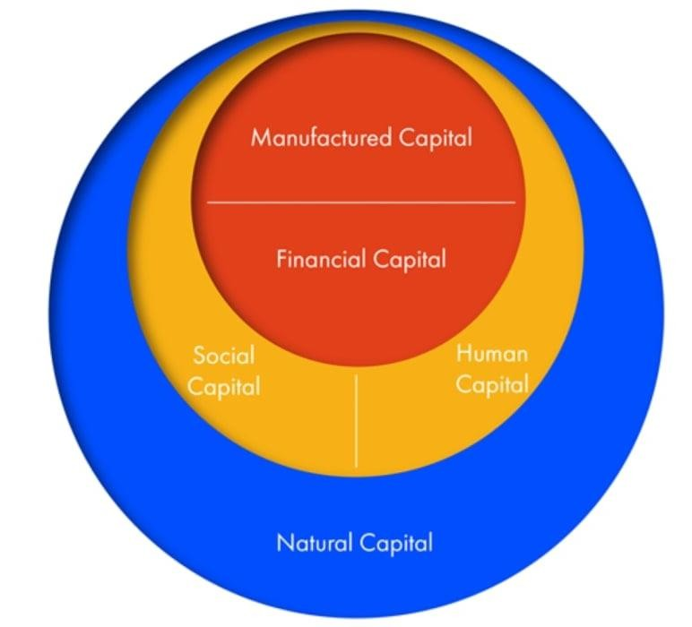

Slide 17
Natural Capital: Includes resources (renewable and non-renewable materials), sinks (absorbing, neutralizing, or recycling wastes), and processes (e.g., climate regulation). Forms the foundation of production and sustains life itself.
Human Capital: Consists of people's health, knowledge, skills, and motivation. Essential for productive work and economic flourishing. Enhancing human capital through education and training is crucial.
Social Capital: Refers to institutions that support and develop human capital in partnership with others. Includes families, communities, businesses, trade unions, schools, and voluntary organizations. Facilitates collaboration, trust, and collective well-being.
Manufactured Capital: Comprises material goods or fixed assets that contribute to the production process. Examples include tools, machines, and buildings.Supports economic activities and output generation.
Financial Capital: Plays a crucial role in the economy, enabling ownership and trade of other types of capital.

Slide 18

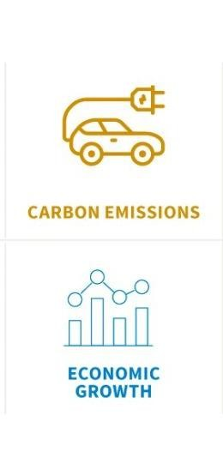
1. Environmental Impact:
Assessing resource consumption, waste generation, emissions, and energy usage.
Focus on minimizing negative environmental effects and promoting sustainable resource management.
2. Social Responsibility:
Addressing social issues and promoting fair labor practices.
Considering employee welfare, community engagement, and ethical supply chain management.
3. Stakeholder Engagement:
Involving diverse stakeholders in decision-making processes.
Considering the interests of employees, customers, communities, and investors.

Slide 19
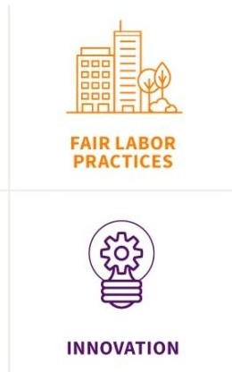

4. Corporate Governance:
Emphasizing transparency, accountability, and ethical behavior.
Promoting responsible decision-making and compliance with legal and ethical standards.
5. Innovation and Adaptability:
Embracing change and finding creative solutions to sustainability
challenges.
Recognizing the importance of continuous improvement and embracing new technologies.
6. Supply Chain Management:
Promoting responsible sourcing and supplier diversity.
Considering environmental and social criteria for supplier selection.

Slide 20



Profit:
Focus on financial performance and profitability.
Assess the economic impact of business activities.
Maximize profits and ensure long-term financial sustainability.
Planet:
Evaluate the ecological impact of business operations.
Minimize negative effects on the environment.
Reduce resource consumption, manage waste and emissions, adopt sustainable practices, and address climate change and biodiversity loss.
People:
Emphasize the social aspect of sustainability.
Promote fair labor practices, employee development, diversity and inclusion, and contribute to societal welfare.

Slide 21

Reduces Business Costs after initial investment
Improves Business Reputation
Connect with Customers with a purpose
Attracts investors and customers

Slide 22
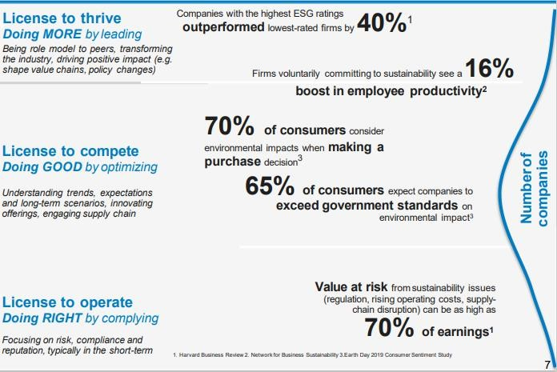

Slide 23
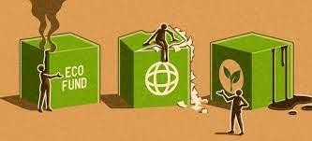

Greenwashing
Greenwashing refers to the practice of misleadingly presenting a company, product, or service as environmentally friendly or sustainable, while its practices or impacts do not align with such claims.
It is a growing concern in sustainability efforts and can undermine trust in businesses and sustainability initiatives.
Global Accounting & Disclosure
Accounting and disclosure initiatives related to sustainability will impact companies worldwide, regardless of their listing status or geographic location.
Companies that already utilize the TCFD framework for reporting will have a head start in complying with the evolving accounting and disclosure standards.
Inflation
Inflation can lead to increased costs for implementing sustainable practices.

Slide 24


Green House Emissions
To secure their supply chains, companies are now being mandated to adopt Science Based Targets, establish Scope 1 and 2 targets, and as of 2023, set targets for reducing Scope 3 emissions.
Geo-Political Issues
Businesses are subjected to geopolitical drivers and events rather than being in control of them.
Collaboration is essential for effectively managing and
mitigating global sustainability challenges.
Conflict and uncertainty hinder progress in addressing these challenges.
Biodiversity concerns
The necessity for companies to comprehend, evaluate, and disclose their dependencies and impacts will continue to rise, playing a progressively vital role in risk management, investment decisions, and capital costs.

Slide 25


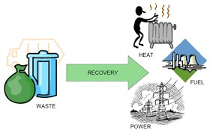
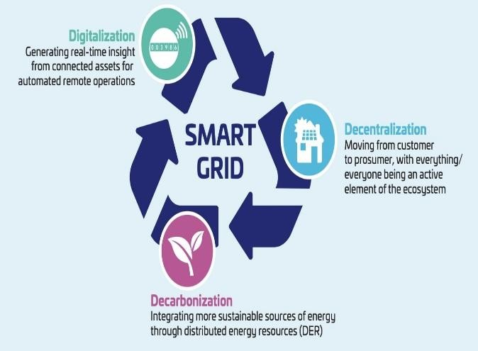
Sustainable technology encompasses innovative solutions that prioritize natural resources and promote economic and social development while aiming to minimize environmental and ecological risks.
Substitution: Sustainable technologies focus on replacing non-biodegradable materials with biodegradable alternatives and shifting from non-renewable to renewable resources during production processes.
Prevention: These technologies are designed to prevent deterioration, contamination, and other adverse environmental impacts throughout their lifecycle, whether in their use or production.
Efficiency: Sustainable technologies emphasize efficient utilization of energy and resources, striving to optimize their performance and minimize waste.

Slide 26
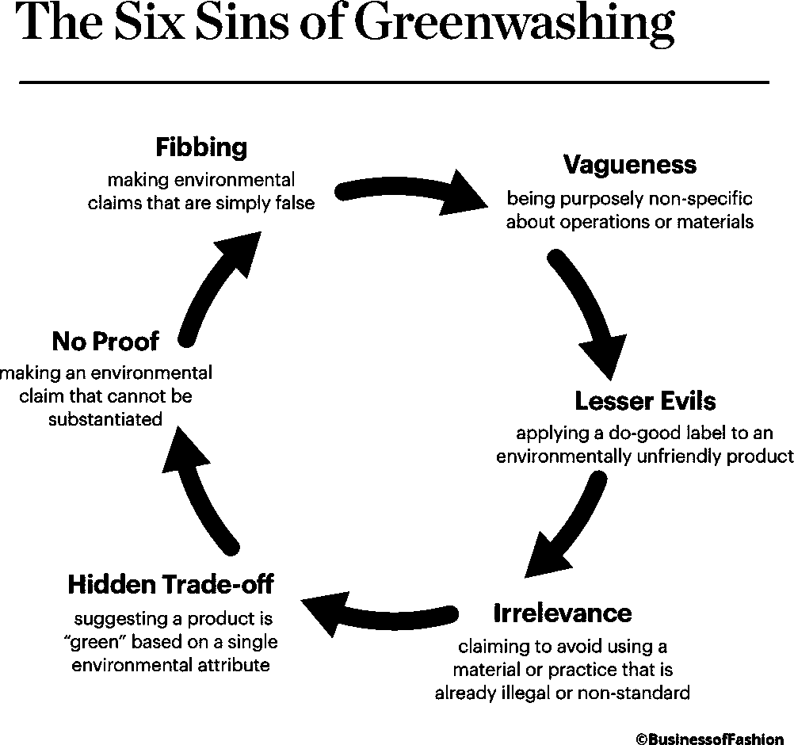
Greenwashing is the process of conveying a false impression or misleading information about how a company’s products are environmentally sound.
Greenwashing involves making an unsubstantiated claim to deceive consumers into believing that a company’s products are environmentally friendly or have a greater positive environmental impact than they actually do.
MITIGATION
Use third-party certifications
Transparent reporting
Avoid vague and unprovable claims
Avoid making irrelevant claims
Walk the talk: investing in renewable energy, reducing waste, or conserving natural resources.
63

Slide 27

Environmental:
Governance:
Set targets for reducing greenhouse gas emissions and energy consumption.
Implement sustainable sourcing practices for raw materials and products.
Ensure board diversity and independence.
Adopt ethical and transparent business practices.
Develop and implement effective risk management processes.
Establish executive compensation tied to
ESG performance.
Implement whistleblower and anti- corruption policies.
Promote shareholder engagement and
Reduce waste and promote recycling and circularity.
Develop and implement environmentally-friendly products and services.
Invest in renewable energy sources and promote energy efficiency.
Social:
accountability
Promote diversity and inclusion in the workplace.
Ensure fair and safe working conditions for employees and suppliers.
Support local communities through philanthropy
and volunteering.
Implement human rights policies and ensure they are respected throughout the supply chain.
Provide access to education and training for
employees and local communities.
Engage with stakeholders to identify and address social risks and opportunities.
6
4

Slide 28

Business Responsibility and Sustainability Reporting
Business Responsibility and Sustainability Reporting (BRSR) is a type of reporting that many companies and organizations use to communicate their environmental, social, and governance (ESG) performance and initiatives to their stakeholders.
BRSR is an important aspect of corporate transparency and accountability.

Slide 29
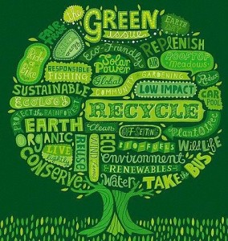

1. BRSR simplifies the problem of reporting framework selection using a unified, transparent reporting format, which all companies will need to adopt.
2. The nationwide regulations and measures present to tackle the climate change issue and to grow the economy in a sustainable manner will certainly become an important focal point in the future.
3. While India’s per capita emissions are among the lowest in the world, it is one of the biggest generators of emissions and is the fastest growing economy, all of which makes sustainability reporting in India important.

Slide 30

Pre-BRSR Era:
1. Before the introduction of BRSR, there were various sustainability reporting frameworks in use in India. However, these frameworks were voluntary, resulting in inconsistency and limited comparability of reporting among companies. This lack of standardization made it challenging for investors and stakeholders to assess the sustainability performance of different companies.
2. The existing frameworks did not comprehensively cover all crucial sustainability topics important to stakeholders. Notably, some frameworks overlooked aspects like human rights and labor practices. The implementation of BRSR addressed these challenges by introducing a mandatory framework covering a wide range of sustainability topics. This has enabled stakeholders to make better-informed comparisons of the sustainability performance among companies.

Slide 31
BRSR’s Strengths, Weaknesses, and Opportunities:
Strengths:
Comprehensive framework covering a wide range of sustainability topics, including governance, ethics, social responsibility, environmental performance, and economic performance.
Alignment with global standards simplifies sustainability reporting for Indian companies to international stakeholders, who show increasing interest in sustainability performance.
Mandatory for the top 1,000 listed companies ensures a uniform standard, ultimately improving sustainability reporting across India.
Weaknesses:
It can be complex and challenging to implement due to numerous requirements, making it difficult for companies to identify relevant ones.
Additionally, reporting requirements may lack clarity, leading to inconsistencies in reporting, mainly because the framework is relatively new and lacks sufficient implementation guidance.
Opportunities:
BRSR aims to enhance transparency and foster responsible and sustainable business practices.
BRSR is closely aligned with global sustainability standards, such as the Global Reporting Initiative (GRI) and the Sustainability Accounting Standards Board (SASB).

Slide 32
Events lead to development of Business Responsibility and Sustainability Reporting (BRSR):
2007: Adoption of Inclusive Growth – 11th Five-year Plan.
July 2011: National Voluntary Guidelines on Social, Environmental and Economic Responsibilities on Business.
August 2012: SEBI makes BRR filing mandatory for top 100 listed Entities.
2015: United Nations Sustainable Development Goals 2030 were released.
2015-16: BRR filing is made mandatory for top 500 listed entities.
March 2019: Revised NVGs released as ‘National Guidelines for Responsible Business Conduct’ (NGRBCs).
August 2020: Committee on BRSR Recommends BRSR Framework with two formats for disclosures.
March 2021: Sustainability Reporting Standards Board of ICAI developed the scoring mechanism of the BRSR i.e., Assigned scores to Business Responsibility and Sustainability Reporting (BRSR).
May 2021: SEBI vide Circular No. SEBI/HO/CFD/CMD-2/P/CIR/2021/562 dated May 10, 2021 referred Applicability and Disclosure format for the Business Responsibility and Sustainability Report (BRSR) replacing the existing Business Responsibility Report (BRR). The new BRSR report is mandatory for the top 1000 listed companies (by market capitalization) from Financial Year 2022-23 and voluntary for Financial Year 2021- 22.
July 2023: SEBI vide Circular No. SEBI/HO/CFD/CFD-SEC-2/P/CIR/2023/122 dated July 12, 2023 had prescribed the BRSR Core & updated BRSR format with an overview on Framework for Assurance & ESG Disclosure for Value Chain.

Slide 33
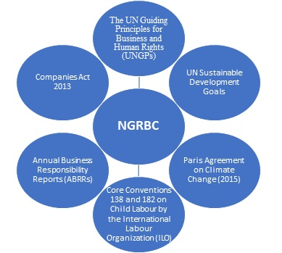
Factors regulating the BRSR

Slide 34

Initiative By MCA:
Considering the importance of sustainability in businesses, MCA launched Corporate Social Responsibility Voluntary Guidelines in 2009. This voluntary CSR Policy addresses six core elements
- Care for all Stakeholders,
- Ethical functioning,
- Respect for Workers’
- Rights and Welfare,
- Respect for Human Rights,
- Respect for Environment and Activities for Social and Inclusive Development.
To take this further, in 2011 MCA issued ‘National Voluntary Guidelines on Social, Environmental and Economical Responsibilities of Business’ which encourages reporting on environment, social and governance issues.
SEBI in its (Listing Obligations and Disclosure Requirements) Regulations, 2015 has mandated the requirement of submission of BRR for top 1000 listed entities describing initiative taken by them from an environmental, social and governance perspective in the prescribed format [Regulation 34(2)(f)].

Slide 35

Applicability:
1. In terms of the aforesaid amendment, with effect from the financial year 2022-2023, filing of BRSR shall be mandatory for the top 1000 listed companies (by market capitalization) and shall replace the existing BRR.
2. Filing of BRSR is voluntary for the financial year 2021-22.
3. The Stock Exchanges are advised to bring the provisions of this circular to the notice of all listed entities and also disseminate the same on their websites.
4. The Circular is issued in exercise of the powers conferred under Section 11(1) of the Securities and Exchange Board of India Act, 1992 read with Regulation 101 of the LODR.

Slide 36

Are unlisted companies covered under BRSR requirements?
As per the MCA committee recommendation, the reporting requirement may be extended by MCA to unlisted companies based on specified thresholds of turnover or paid-up capital.
Further, the committee recommends that on a voluntary basis, smaller unlisted companies below this threshold limit may adopt a lite version of the format. Two formats for disclosures are available; a comprehensive format for listed companies; and a lite version for unlisted companies, in case it is extended to them.

Slide 37
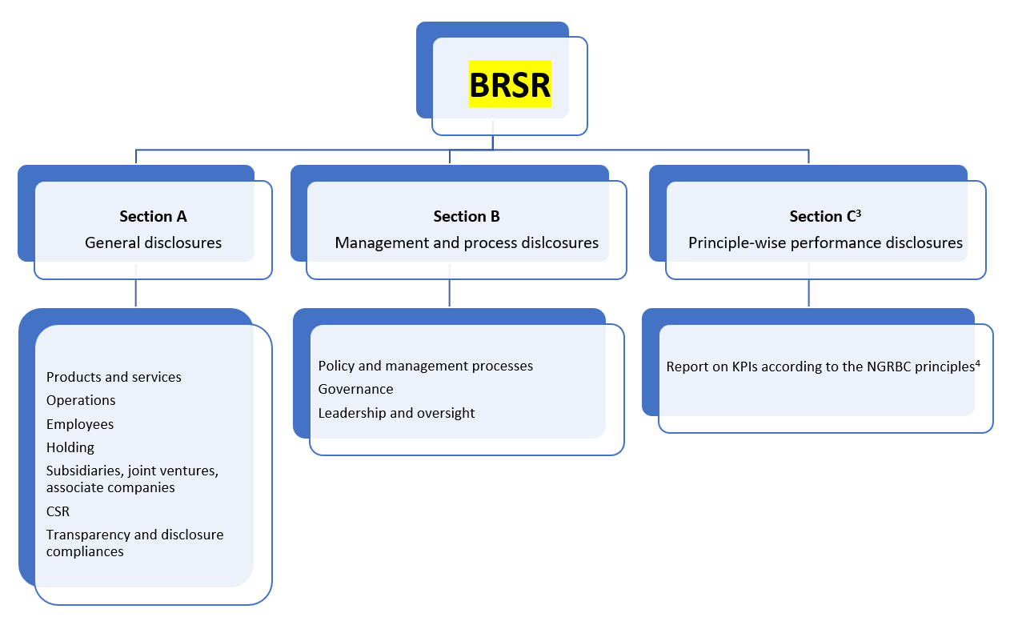
BRSR FLOWCHART

Slide 38

The BRSR report format will consist of three sections:
1. General disclosures: The objective of this section is to obtain basic information about the company – size, location, products, number of employees, CSR activities, etc.
2. Management disclosures: In this section, the company is required to disclose information on policies and processes relating to the NGRBC Principles concerning leadership, governance, and stakeholder engagement. Wherever relevant, companies have been asked to provide links to their websites where these policies are available.
3. Principle-wise disclosures: Responses to this section indicate how a company is performing in respect of nine Principles and Core Element of the NGRBCs. This section requires companies to demonstrate their intent and commitment to responsible business conduct through actions and outcomes.

Slide 39
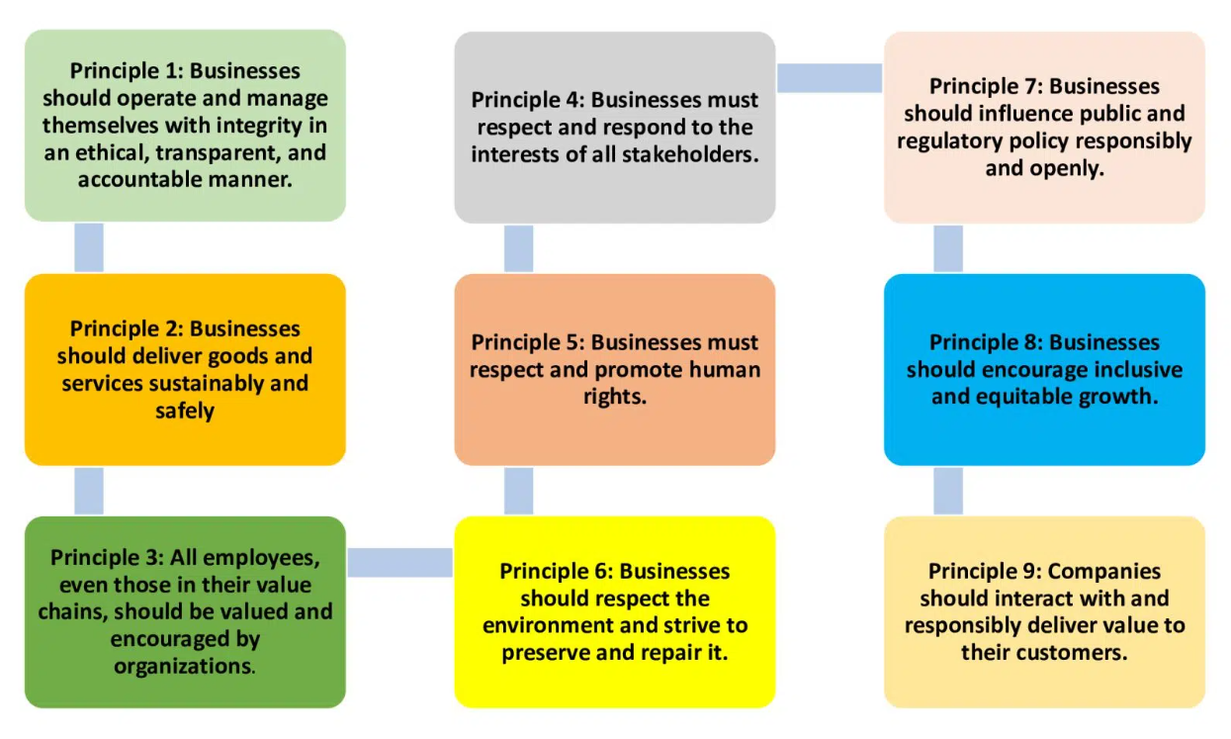
BRSR PRINCIPLES

Slide 40
PRINCIPLE 1: Businesses should conduct and govern themselves with integrity, and in a manner that is Ethical, Transparent and Accountable. This principle focuses on the importance of ethical conduct and transparency in business operations. Companies should follow ethical business practices and adhere to high standards of integrity. They should also be transparent about their activities, operations, and financial reporting, as well as be accountable for their actions.
PRINCIPLE 2: Businesses should provide goods and services in a manner that is sustainable and safe. This principle highlights the importance of sustainable and safe production practices. Companies should strive to minimize the environmental impact of their activities and ensure that their products and services are safe for consumers and the environment.
PRINCIPLE 3: Businesses should respect and promote the well-being of all employees, including those in their value chains. This principle emphasizes the importance of employee well-being. Companies should provide safe and healthy working conditions, fair wages, and opportunities for career development to all employees in their value chains, including suppliers, contractors, and temporary workers.
PRINCIPLE 4: Businesses should respect the interests of and be responsive to all its stakeholders. This principle highlights the importance of stakeholder engagement. Companies should consider the interests and perspectives of all stakeholders, including shareholders, employees, customers, suppliers, and the communities in which they operate. They should also be responsive to stakeholder concerns and feedback.

Slide 41
PRINCIPLE 5: Businesses should respect and promote human rights. This principle focuses on the importance of human rights. Companies should respect and promote human rights, including the rights to freedom of expression, association, and privacy. They should also prevent and address human rights violations in their operations and value chains.
PRINCIPLE 6: Businesses should respect and make efforts to protect and restore the environment. This principle emphasizes the importance of environmental stewardship. Companies should minimize their impact on the environment, conserve natural resources, and promote environmental sustainability. They should also take steps to restore and rehabilitate degraded ecosystems.
PRINCIPLE 7: Businesses, when engaging in influencing public and regulatory policy, should do so in a manner that is responsible and transparent. This principle highlights the importance of responsible advocacy. Companies should engage in policy advocacy in a responsible and transparent manner, and avoid engaging in activities that could undermine the public interest or the democratic process.
PRINCIPLE 8: Businesses should promote inclusive growth and equitable development. This principle emphasizes the importance of promoting inclusive and equitable economic development. Companies should create economic opportunities for all, including disadvantaged and marginalized groups. They should also contribute to the development of local communities and support social and economic empowerment.
PRINCIPLE 9: Businesses should engage with and provide value to their consumers in a responsible manner. This principle highlights the importance of responsible consumer engagement. Companies should provide safe, high-quality products and services, and ensure that they are marketed and sold in an ethical and responsible manner. They should also be transparent about their products and services, and provide consumers with the information they need to make informed choices.

Slide 42

BENEFITS OF BRSR:
1. Improved Reputation
2. Engagement of Stakeholder
3. Competitive advantages
4. Risk Management
5. Saving and Efficiency
6. Regulatory Compliances
7. Investor attraction and capital access
8. Employee Retention
9. Future Proofing and Innovation
10. Positive Society Impact

Slide 43
Practical Challenges and Solutions in Meeting Challenges in meeting BRSR Standards:
Data Gathering: The time-consuming data collection process constantly challenges BRSR reporting. Indeed, generating BRSR data requires information from various internal and external sources, including multiple departments within your organization, supply chain partners, competitors in the industry, and third-party data suppliers.
Data Administration and Verification: Your data has been collected, but it must still be handled and checked for accuracy, completeness, and dependability. It’s normal for organizations to be concerned about the BRSR reporting difficulty of data management and verification.
Communication and Engagement with Stakeholders: Another common issue in BRSR reporting is managing stakeholder relationships, which is crucial to moving your sustainability projects forward. On the one hand, regular involvement sheds light on stakeholder expectations, enables the collection of pertinent data, and promotes trust. On the other hand, communication ensures that BRSR information reaches stakeholders on time, which is critical for encouraging accountability and informed decision-making. However, it is easier said than done. With so many moving variables, it cannot be easy to please everyone while advancing your team’s most Important BRSR goals.
BRSR Factors Measuring and Quantifying: Despite this being an important step, organizations frequently need help to adequately evaluate and quantify their sustainability programs’ effectiveness. The subjective nature of BRSR elements, the lack of standardized measurements, and the complexity of capturing the intangible aspects of sustainability success can all contribute to these challenges.

Slide 44

Solutions in meeting BRSR Standards:
a. Elevate the intangible: Create novel techniques to capture and express the intangible components of your BRSR performance. One strategy is to use qualitative indicators and storytelling in addition to quantitative measurements. This enables organizations to present a comprehensive view of their BRSR performance, including qualitative accomplishments that may be difficult to quantify but are noteworthy.
b. Engage ESG reporting specialists: Seek advice from ESG reporting professionals or consultants who are well-versed in various sustainability frameworks and the ESG reporting process. These specialists can offer valuable insights, aid in interpreting sustainability principles and standards, and make recommendations for effective reporting and narrative presentation.
c. Make use of ESG reporting software: Use ESG reporting software solutions that are specifically built to fit with industry best practices. If you seek a specific framework or standard, ensure the software is certified. These software applications frequently provide built-in capabilities and templates that streamline the reporting process while assuring compliance with particular requirements.

Slide 45
What is BRSR Core?
The Business Responsibility and Sustainability Reporting (BRSR) Core is a subset of the wider Business Responsibility and Sustainability Reporting (BRSR) framework introduced by SEBI as an ESG-based voluntary disclosure regime. It relates to what SEBI has identified as critical elements of BRSR. It is a mandatory requirement for the largest Indian companies by market capitalization from 2023 onwards on phase rolled out.
BRSR Core requires companies to go beyond their own direct operations and make disclosures and obtain assurance as per ‘BRSR Core’ for their value chain. Like the overarching BRSR framework, BRSR Core is based on the principle of “comply or explain” requiring entities to disclose their ESG-related information as per the prescribed format or provide a valid reason for not doing so. The framework covers various aspects of sustainability, including governance, environment, social, customer, supply chain, and human rights.
BRSR Core draws upon international guidelines such as the OECD Guidelines for Multinational Enterprises, human rights conventions defined by the International Labour Organisation (ILO) and three specific environmental conventions (Minamata Convention, Stockholm Convention and Basel Convention) and is part of a growing trend towards greater corporate responsibility for human rights and the environment in global supply chains. Several other countries, including Canada, Norway, France and Germany, have also implemented similar regulation in recent years. The intention is, however, for this new piece of SEBI legislation to have an Indian perspective that recognises India’s developing country status and, also, its role as a key manufacturing hub supporting the economies of more developed nations.
In July 2023, SEBI added new ESG metrics for mandatory disclosure under ‘BRSR Core’ for certain listed companies in India. The Business Responsibility and Sustainability Report (BRSR) format was initially introduced in May 2021 and replaced the previous Business Responsibility Report (BRR). While SEBI has stipulated a timeline for mandatory compliance under the BRSR Core, as of FY 2023, all of the top 1000 listed companies by market cap in India must file their BRSR Report.
BRSR Core is a significant development in India’s approach to supply chain regulation. This law requires companies to report on the actions they have undertaken throughout their supply chains across 11 different categories. At the moment, it applies only to India’s biggest public companies. There is a phased timetable for introduction over the next few years.
BRSR Core is in step with other moves globally to introduce legislation to help create a more responsible global economy but is likely to have a distinctly Indian perspective that appreciates India’s developing economy and role as a major manufacturing centre for the world.
BRSR Core is a positive development that has the potential to create a more ethical supply chain ecosystem. By prioritizing the well-being of workers, communities, and the environment, companies can build a stronger and more resilient global economy for the future.

Slide 46

What happens if a company fails to comply with BRSR Core?
As yet, SEBI has not defined any penalties for non-compliance with BRSR Core. It may be that, given the requirement applies to only the biggest organisations in India, it feels it can rely on businesses to do the right thing without needing drive behaviour with the threat of fines or prosecutions.
There is also an indication that SEBI will be sensitive to the stage that India is at in its ESG journey and wait before implementing reporting standards and/or enforcement.

Slide 47
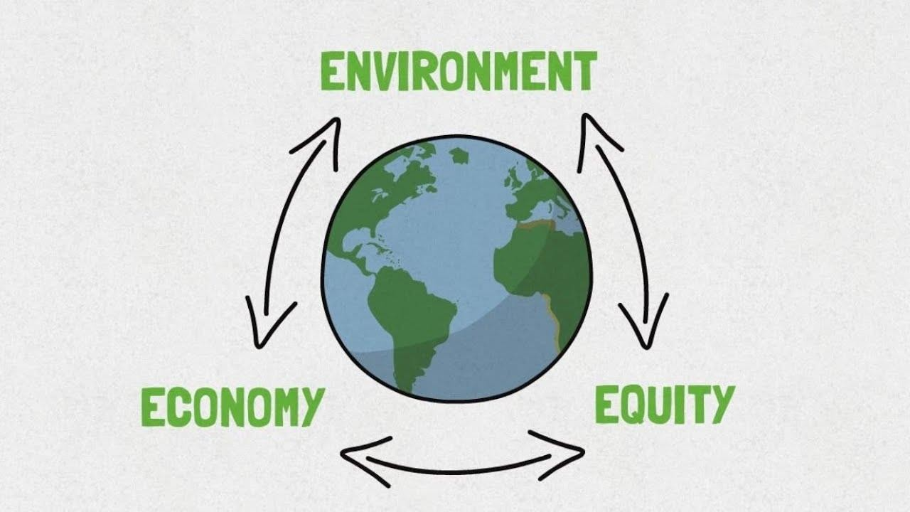
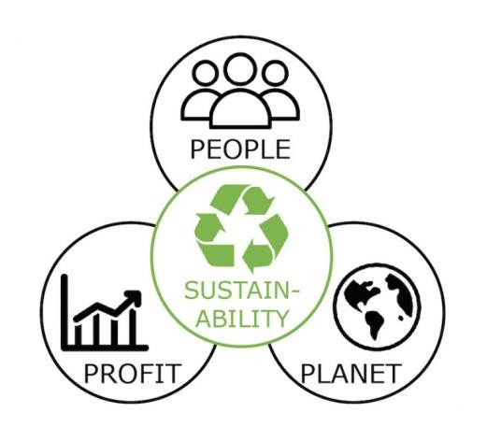


Slide 48

